Slide 1
Autonomous Vehicle: Sensors, V2V, and Uncertainty
COMP 790-058 Multi-Agent Simulation for Crowds and Autonomous Driving
Presenter: Shiwei Fang

Slide 2
Outline
Sensors
V2V
Uncertainty

Slide 3
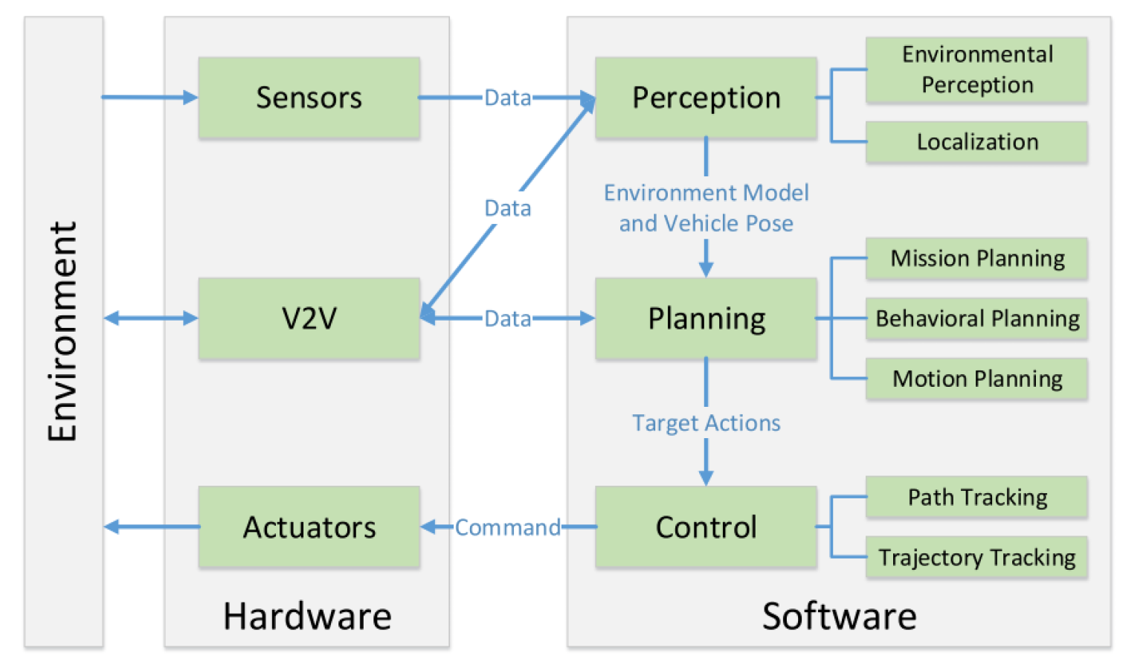
Refresh

Slide 4
Sensors
Voyage

Slide 5
LIDAR
Light Detection and Ranging
Sometimes: Light Imaging, Detection, And Ranging

Slide 6
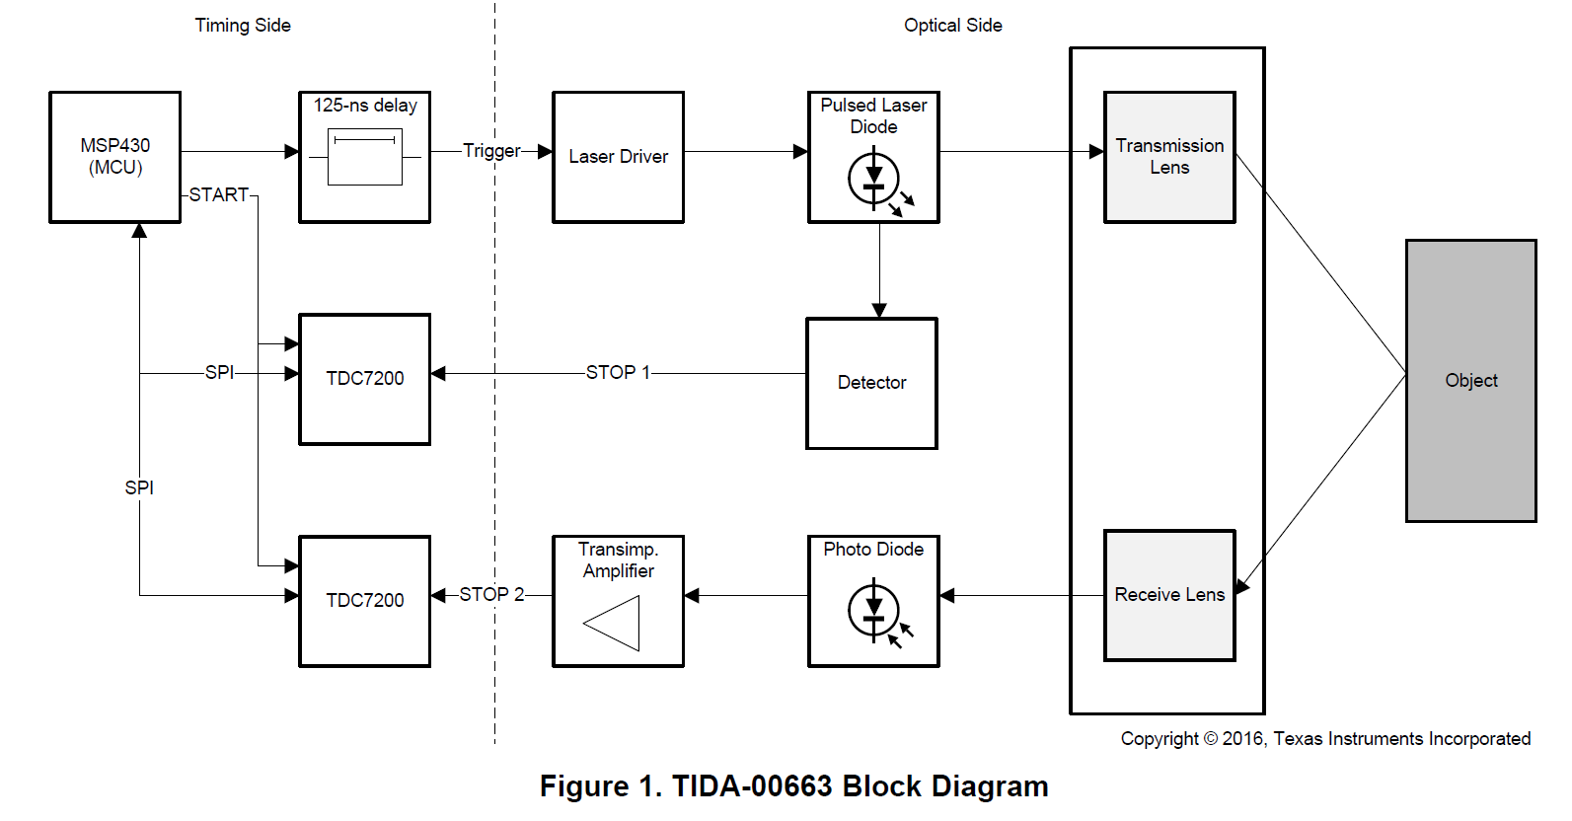
How it works
Emit laser and receive the reflection
Time of flight
Time-to-Digital Converter (55ps)
Notes:
LiDAR works by measure the time of flight which is the time take for the laser pulse to hit the target and bounce back. Here is a block diagram of pulsed time of flight reference design. The two TDC 7200 chips are Time-to-Digital Converter which has a resolution of 55 ps. 5.5 x10^-11 seconds.

Slide 7
Types
Mechanical
Solid-State

Slide 8
Types
Mechanical
Most common one right now
Rotate the sensor to get 360 degree view
Multiple beams to cover vertical field of view
High Cost ~$80,000
Large in size
Solid-State

Slide 9
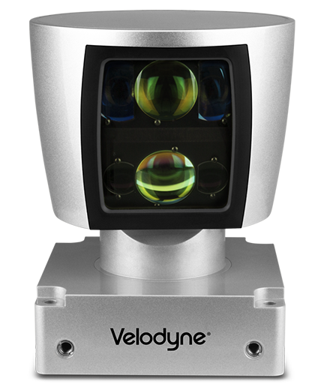
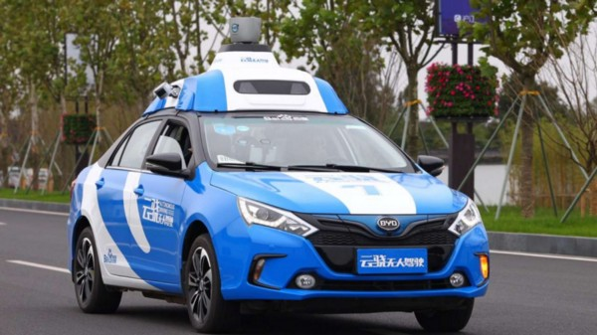
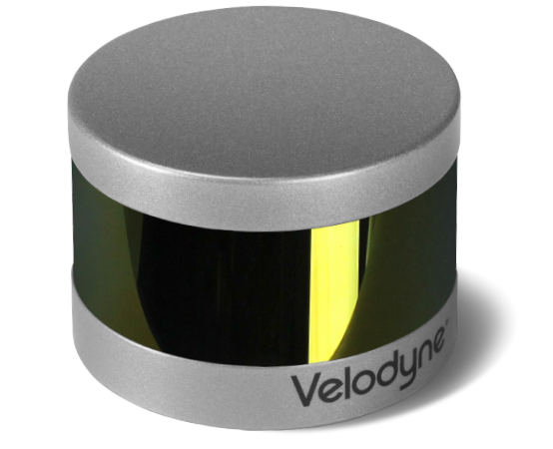
Most mount the major one on top of the vehicle.
And mount the smaller one on side and etc.

Slide 10
Types
Mechanical
Solid-State
No mechanical part
More robust
Saving in cost (sub $500 target)
Only a limited filed of view

Slide 12
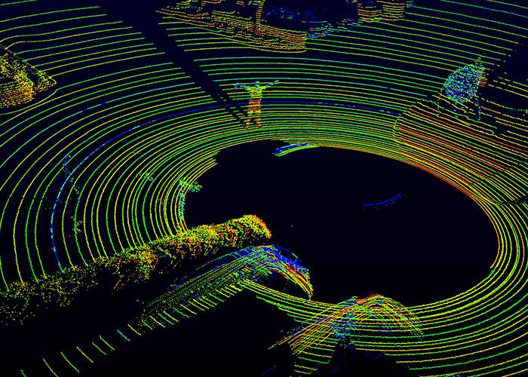
Limitations
Heavy fog, rain, snow…
Angle resolution
Google Waymo: long range LIDAR, short range LIDAR
Need to be in line of sight
Does not work with glass
Nor mirror

Slide 13
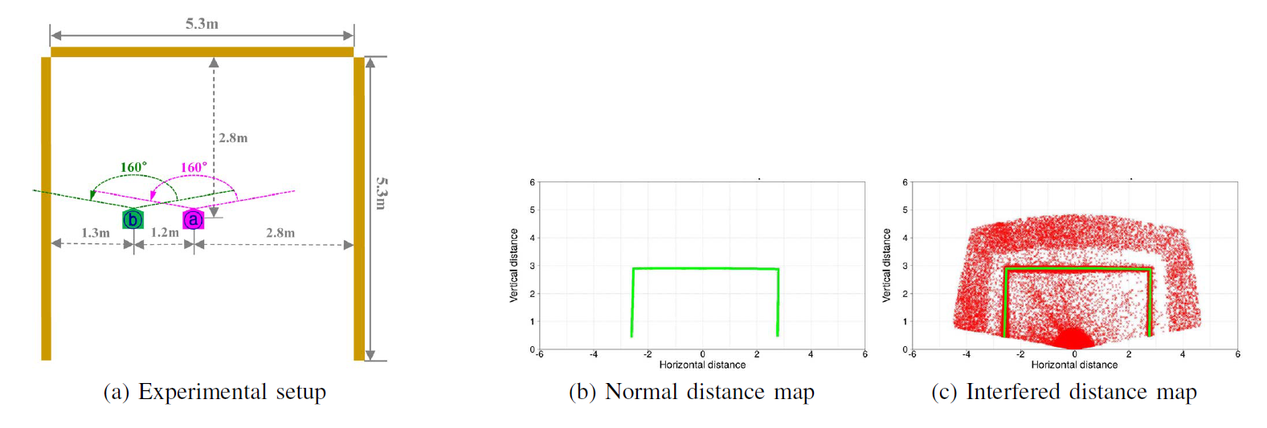
Safety
Interference between multiple LIDAR
G. Kim, J. Eom and Y. Park, "Investigation on the occurrence of mutual interference between pulsed terrestrial LIDAR scanners," 2015 IEEE Intelligent Vehicles Symposium (IV), Seoul, 2015, pp. 437-442.

Slide 14
Safety
Interference between multiple LIDAR
G. Kim, J. Eom and Y. Park, "Investigation on the occurrence of mutual interference between pulsed terrestrial LIDAR scanners," 2015 IEEE Intelligent Vehicles Symposium (IV), Seoul, 2015, pp. 437-442.

Slide 15
Safety
Interference between multiple LIDAR
G. Kim, J. Eom and Y. Park, "Investigation on the occurrence of mutual interference between pulsed terrestrial LIDAR scanners," 2015 IEEE Intelligent Vehicles Symposium (IV), Seoul, 2015, pp. 437-442.

Slide 16
Possible Solutions
Modulation
Different frequency

Slide 17
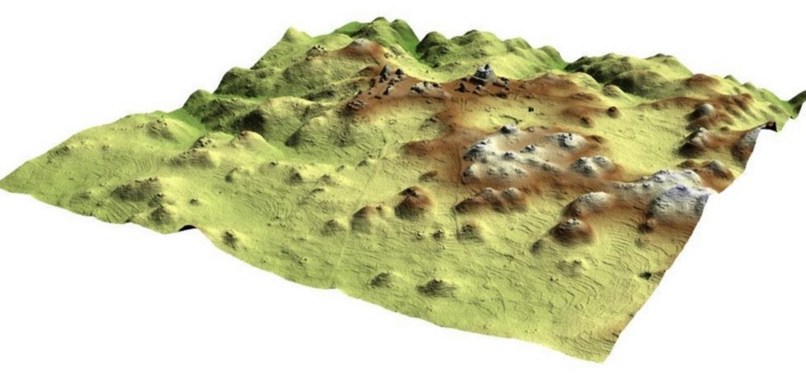
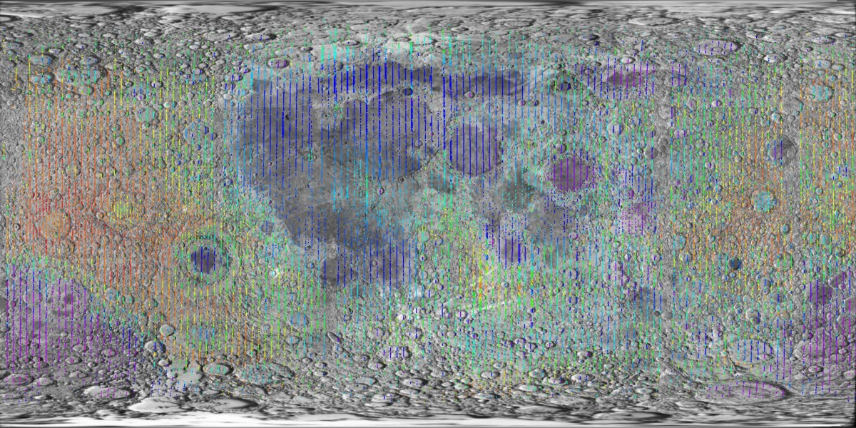
Other Use of LIDAR
LIDAR Map (aircraft, space)
Aerially-captured LIDAR map
Moon

Slide 18
Camera
We see and use everyday
Cheap
Information rich
Every autonomous car has camera(s)

Slide 19
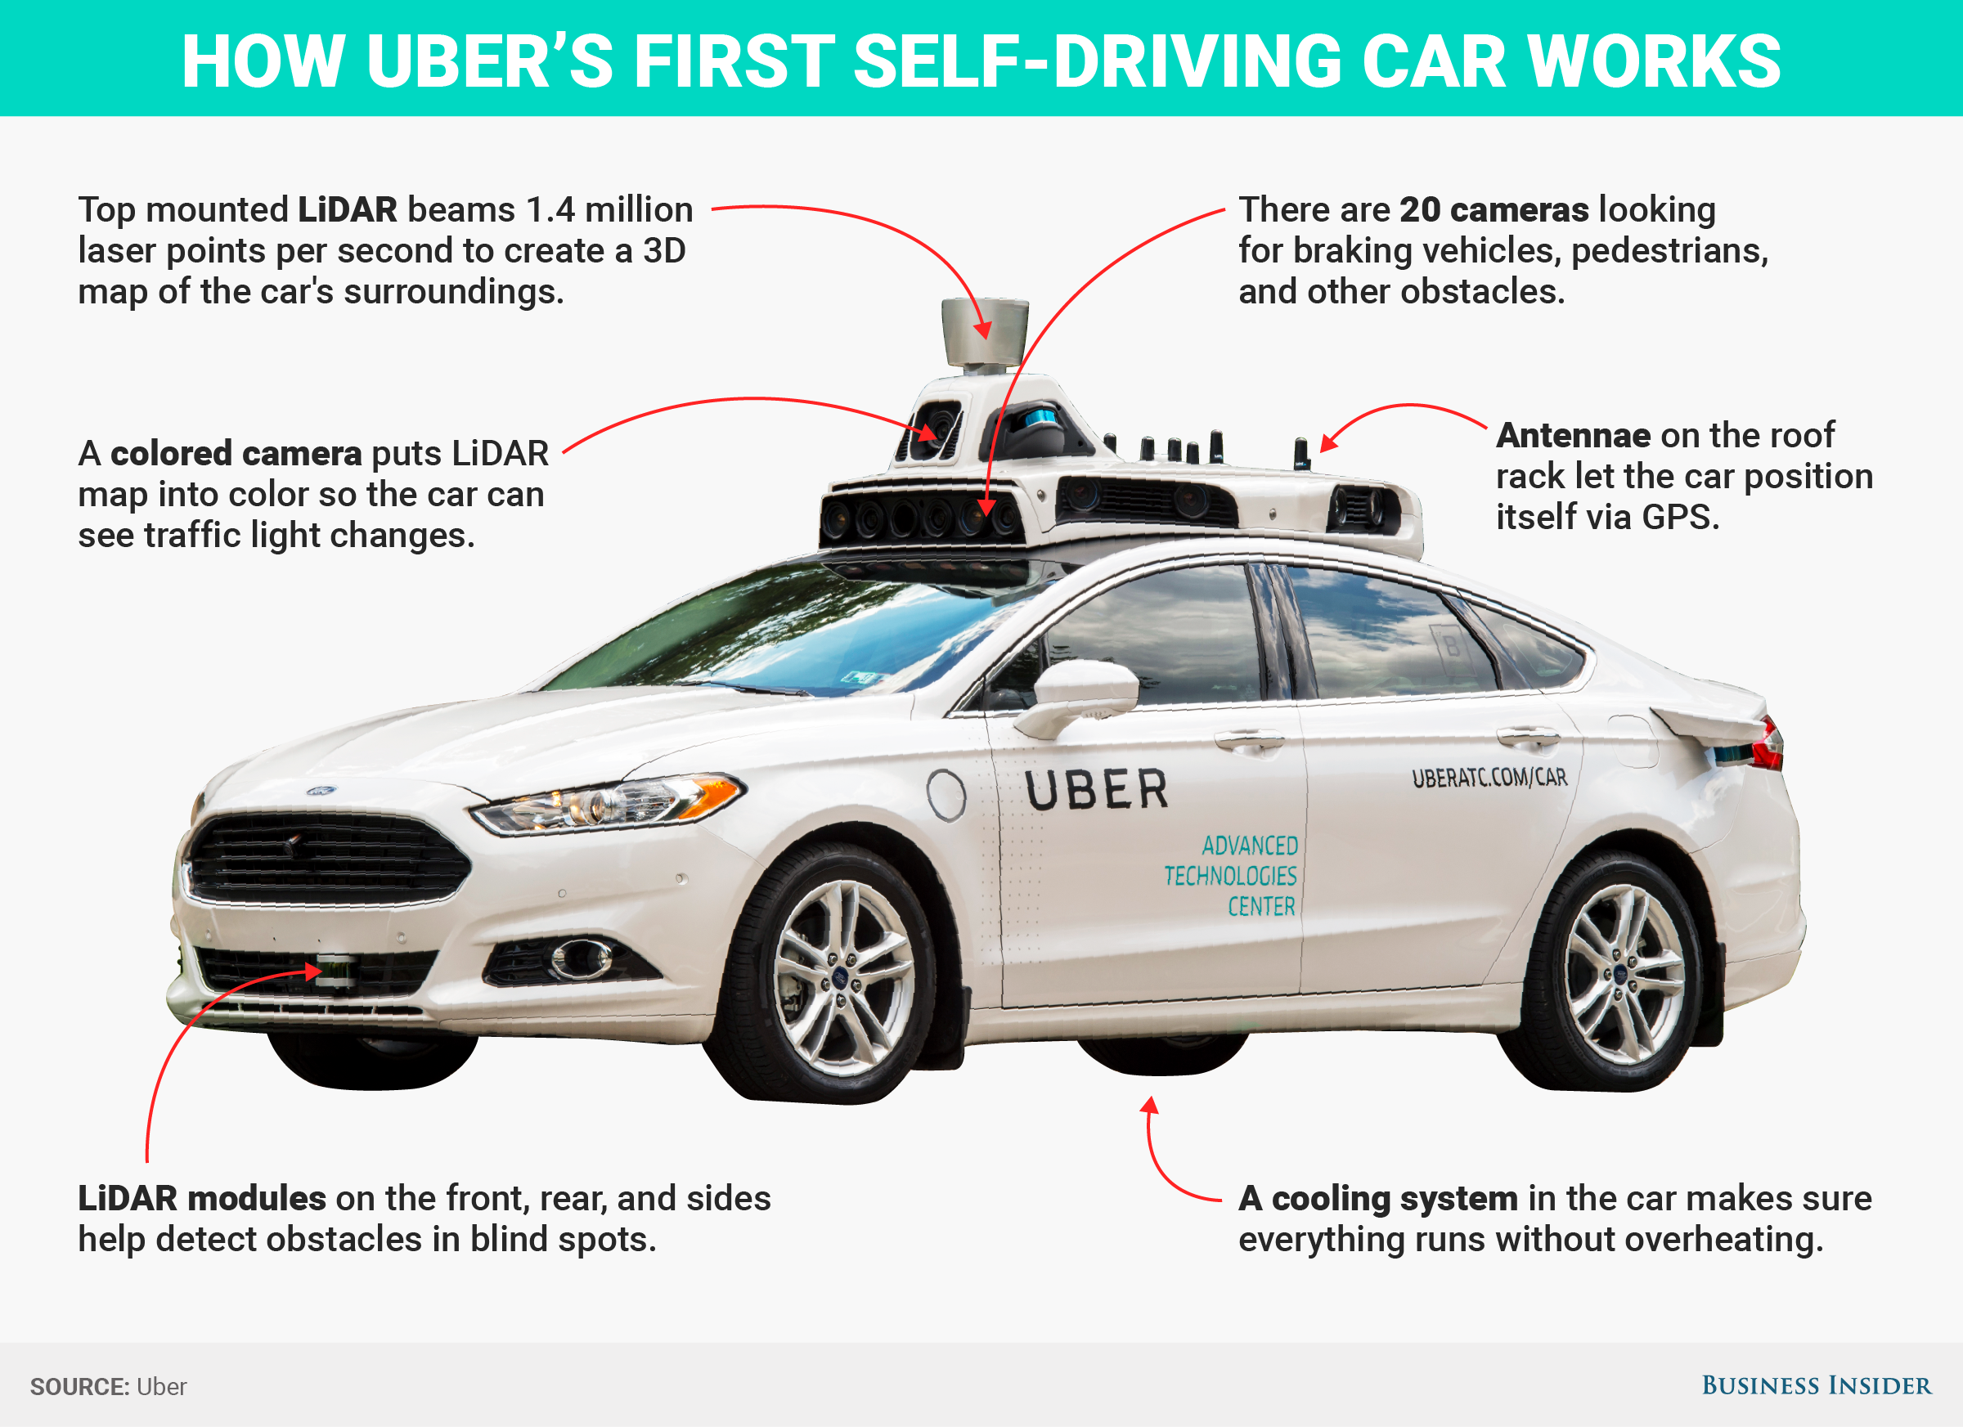
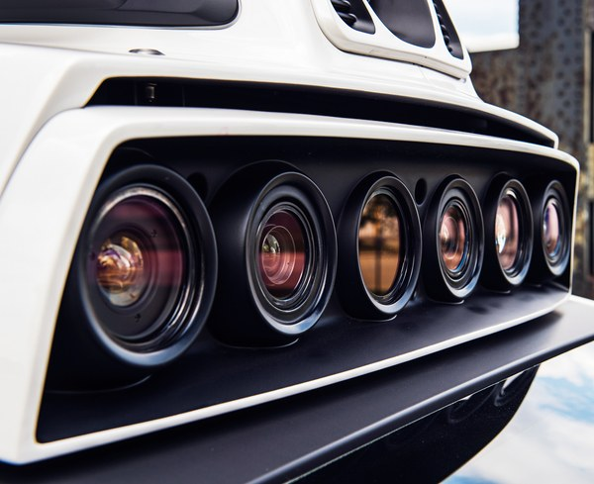

Slide 20
Limitations
Fog, rain, snow…
Lighting
Resolution
Focus range
Flare
Glass
Mirror
Needs to be in line of sight

Slide 21
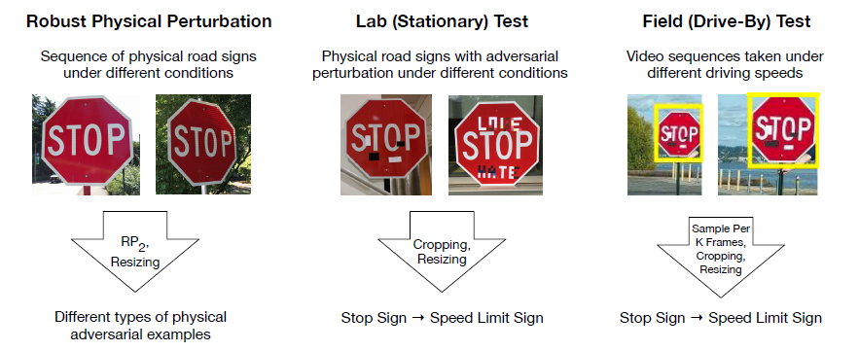
Safety
Assume perfect image
Road sign become speed limit
Adversarial attack
Evtimov, Ivan, et al. "Robust Physical-World Attacks on Deep Learning Models." (2017).

Slide 22
Athalye, Anish, and Ilya Sutskever. "Synthesizing robust adversarial examples." arXiv preprint arXiv:1707.07397(2017).
Notes:
One paper state that given from different angles due to the motion of camera, the classification should be robust enough to not classify all the images from different angles wrong. But that’s not the case.

Slide 23
What else is used

Slide 24
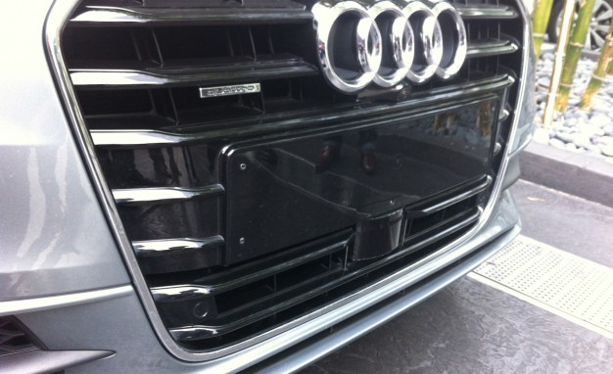
Radar
mmWave Radar (60GHz – 80 GHz)
Used in ACC (some use camera)
Radio frequency bounce back
Not affected by weather!
Not affected by lighting!
Notes:
WiFi and Bluetooth is 2.4GHz. GSM phone around 900 Mhz.

Slide 25
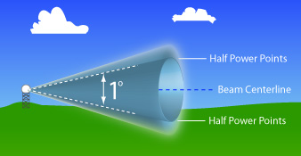
Limitations
Beam width
Not a straight line like laser
Resolution is low
Extremely hard to identify the object detected
Frequency used in autonomous car can not penetrate objects

Slide 26
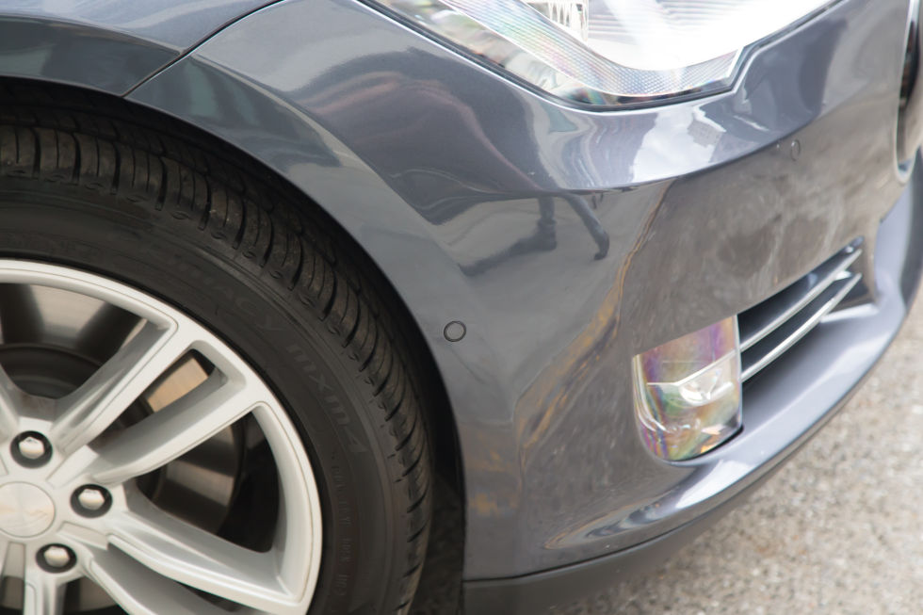
Ultrasonic
Parking sensor
Short range (~5m)
Cheap

Slide 27
Limitations
Short range
Beam width
Sensor needs to be clean, weather will affect
Unable to identify objects
Does not penetrate objects

Slide 28
Sensor Fusion
Combine different sensors’ data
Determine situation from all the data

Slide 29
Challenges
Which sensor data should be give more weight?
Tesla autopilot crashes
Camera mistook trailer as sky
mmWave radar didn’t detect cars parked partially on the road
How to determine which sensor is functioning correctly if data conflicts with each other?

Slide 30
Limitations of All Sensors
Needs to be in line of sight
Autonomous vehicles needs more information
Notes:
Autonomous car can work with limited sensing information , however, in such situation they can plan far ahead. Imaging if we can share all the data.

Slide 31
Automated Driving Leaderboard
Navigant Research
Notes:
This is a report is done by Navigant Research. Compares companies ability to research and

Slide 32
Tesla and Waymo
Tesla
Waymo
Camera
Radar
Ultrasonic sensor
Ask buyer to pay $8,000 for “Full Self-Driving Capability”
Installed on Model S,X,3
Needs to be low cost enough to attract buyers
Model 3 start around $35,000
Read speed limits, drive on road
Level 2.5ish
Claims the system can handle level 5
People skeptic about lack of LIDAR
Camera
Radar
LIDAR
Launched since 2009, “DARPA”
Partnering with car manufactures
Chrysler Pacific Mini Van
In-house sensors, everything
10% of original cost of LIDAR => $75,000 *10%=$7,500 per unit
Each car has 3 LIDAR, ride-sharing
Hi-definition Map, pre-record every street the car will be driving
Working on level 5
Notes:
Tesla has teo generations of autopilot hardware, AP1 and AP2, AP3 is Mobileye EyeQ3, AP2 is in house development. Radar, camera, Nvidia GPUs.

Slide 33
Smart Cities
Use large amount of sensors to monitor the city
Connected things/ internet of things
Weather, crowd density, etc.
Infrastructure condition
Traffic light
Road surface condition

Slide 34
Intelligent Transportation Systems
Part of Smart Cities
Traffic Management Systems
Traffic jam
Parking space

Slide 35
Connected Vehicles
Lu, Ning, et al. "Connected vehicles: Solutions and challenges." IEEE internet of things journal 1.4 (2014): 289-299.

Slide 36
Vehicle to Vehicle
V2V
Not limited to only between vehicles
V2I (vehicle to infrastructure)
Hybrid of V2V and V2I

Slide 37
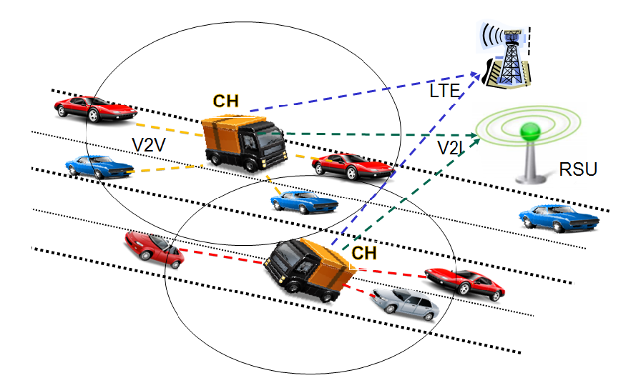
RSU: Road Side Unit
Maglaras, Leandros A., et al. "Social internet of vehicles for smart cities." Journal of Sensor and Actuator Networks 5.1 (2016): 3.

Slide 38
Challenges
Which vehicle should you talk to?
Communication bandwidth
Where should the data being processed? Cloud or vehicle?
Internet unavailable
Attack on the network

Slide 39
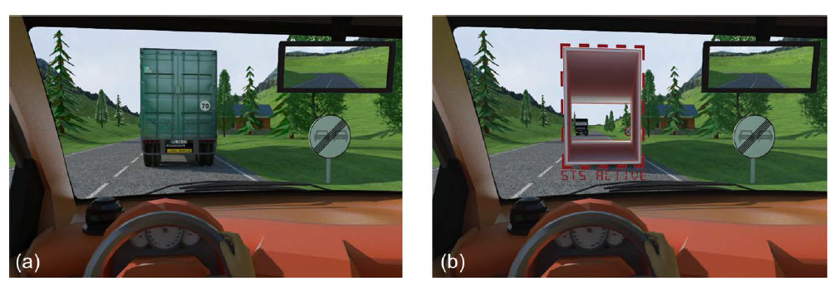
Directly to Font Vehicle
Use front vehicle’s camera to allow object see-though
Bandwidth?
Gomes, Pedro, Cristina Olaverri-Monreal, and Michel Ferreira. "Making vehicles transparent through V2V video streaming." IEEE Transactions on Intelligent Transportation Systems 13.2 (2012): 930-938.

Slide 40
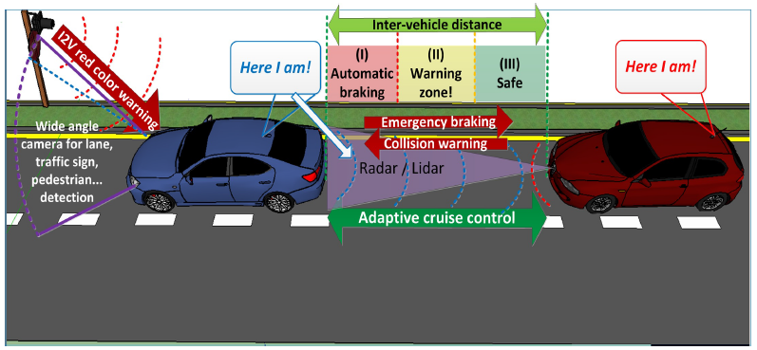
Visible Light Communication
Talk to nearby vehicles, limited information
Cailean, Alin-Mihai, et al. "A survey on the usage of DSRC and VLC in communication-based vehicle safety applications." Communications and Vehicular Technology in the Benelux (SCVT), 2014 IEEE 21st Symposium on. IEEE, 2014.

Slide 41
Industry Products
Google Map, Here Map
Real-time traffic data
Street view
Waze
Community map
Mobileye
Road Experience Management ™ (REM™)

Slide 43
But
Even vehicle to vehicle can not eliminate uncertainty
Motion planning needs to take care of

Slide 44
Simple Intuition
Stop the vehicle
Wait till the sensor gives certain measurement
Not practical
Some cases cannot be measured
Other vehicles always have a possibility to break rule

Slide 45
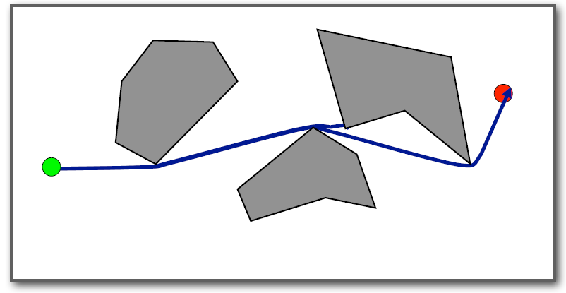
Work on Obstacle

Slide 46
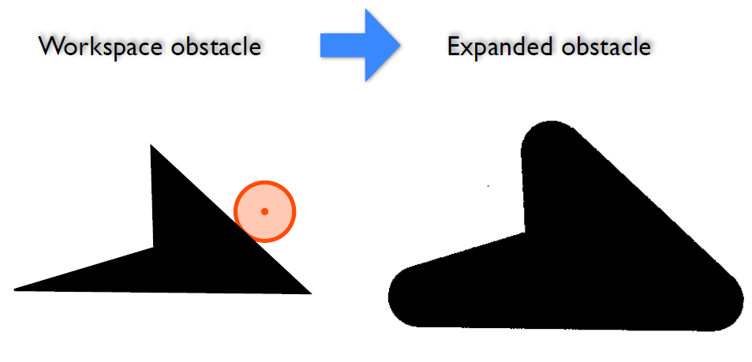
Work on Obstacle
Minkowski Sum

Slide 47
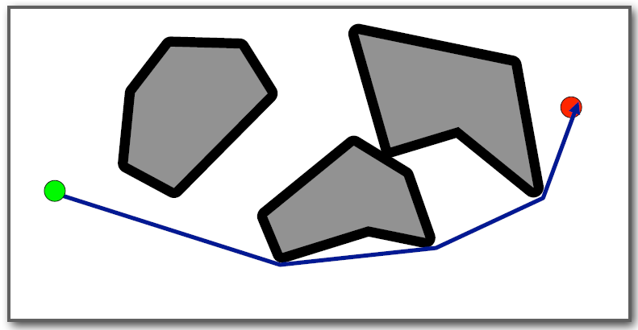
Work on Obstacle

Slide 48
Close Loop Real-time Re-planning
Sense
Plan
Move

Slide 49
Other Methods
Markov Decision Process Model
Motion planning with conservative constrains

Slide 50
Probability Model
Treat front wheel angle as prior data
Calculate trajectories based on the probability model
Find the path that has no or low probability of collision

Slide 51
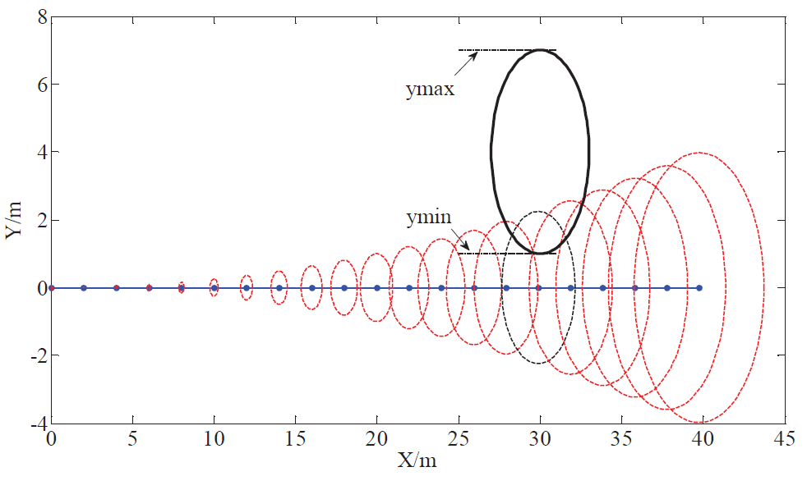
Sun, Hao, et al. "Trajectory planning for vehicle autonomous driving with uncertainties." Informative and Cybernetics for Computational Social Systems (ICCSS), 2014 International Conference on. IEEE, 2014.

Slide 52
Motion Planning Under Uncertainty
Predict other vehicles’ path use local planner
Calculate uncertainty along the path using Gaussian Propagation
The uncertainty from localization and control is estimated based on Linear-Quadratic Gaussian (LQG) framework

Slide 53
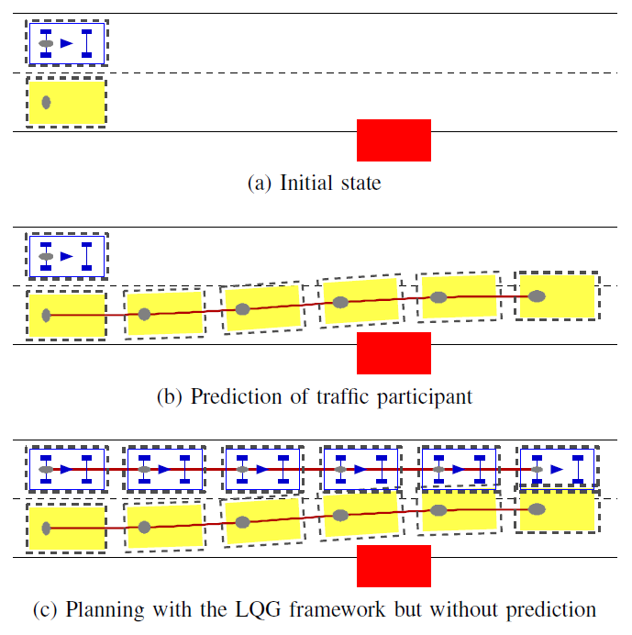
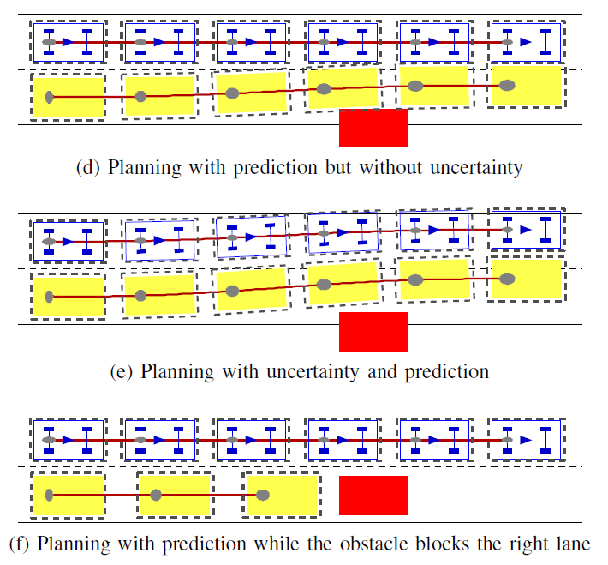
Sun, Hao, et al. "Trajectory planning for vehicle autonomous driving with uncertainties." Informative and Cybernetics for Computational Social Systems (ICCSS), 2014 International Conference on. IEEE, 2014.

Slide 54
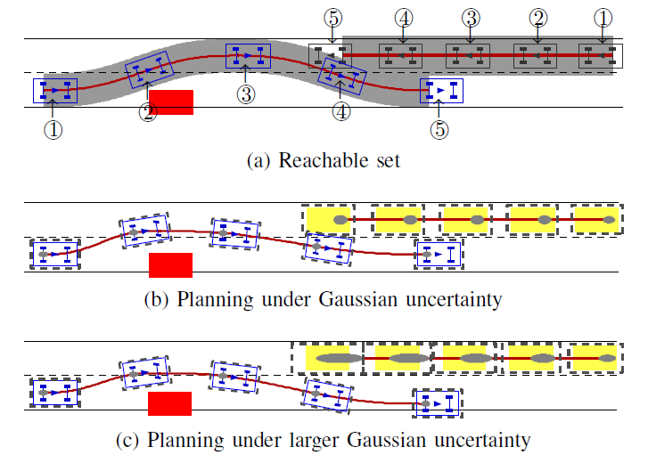
Sun, Hao, et al. "Trajectory planning for vehicle autonomous driving with uncertainties." Informative and Cybernetics for Computational Social Systems (ICCSS), 2014 International Conference on. IEEE, 2014.

Slide 55
Summary
Sensors: LIDAR, camera, radar, ultrasonic
Each has its own limitations
Fusion is not easy
Use V2V, V2I for “superman” sensing
Network management
Universal standard
Trying to minimize uncertainty
Planning under uncertainty
Simple model
Prediction
Probability distribution

Slide 56
Thanks!
Shiwei Fang

